Slide 1

OCR4all
By Gunja Sarkar
OCR4all is an Optical Character Recognition program (recognizes fancy text from an image, regardless of language or script)
Developed by Julius-Maximilians-Universität Würzburg under direction of Christian Reul, as part of the Kallimachus joint project (joint project between computer science and humanities).
Funded by Federal Ministry of Education, continued and institutionalized in the Center for Philology and Digitality. Two-year OCR4all-libraries project approved and funded by German Research Foundation in July 2021.

Slide 2
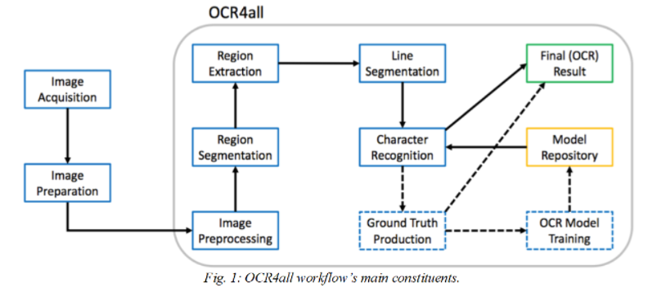
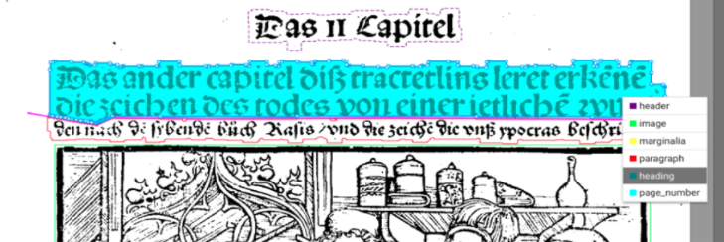
Overview of the Open Source System
Download and install start-up software
VirtualBox
Docker
OCR4all starter file (compressed, 3.3 GB)

Slide 3
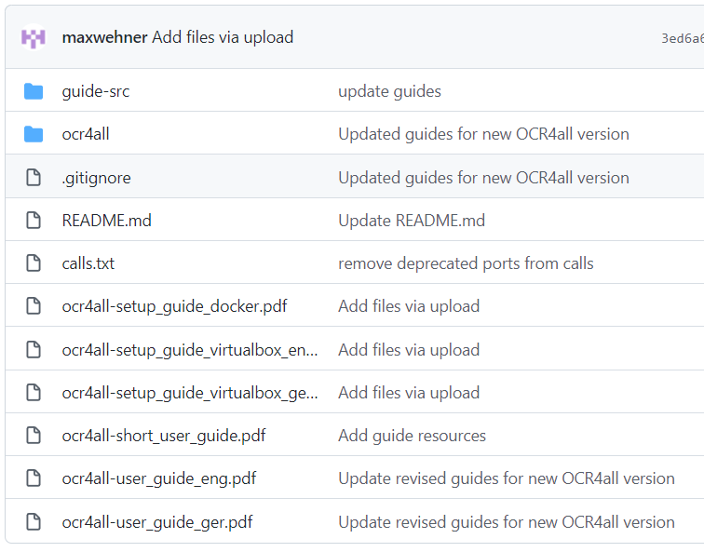
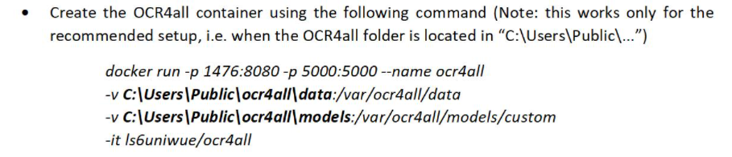
Trying it out…
Confusing/cumbersome set up
Hard to know where to start
Created by German university
Model training vs source code contribution?

